Slide 1
Big data and Analytics for non-financial information
Carlos Fernández Iñigo
Deputy General Manager
44th World Continuous Auditing and Reporting Symposium (Sevilla)

Slide 2

Which was our starting point?
Information Sources
Treatment over veracity
Company Analysis
On-demand
Batch information
Online
Transactional data
WEB
API

Slide 3
BUT EVERYTHING CHANGED…

Slide 4
A LARGE DATABASE
Storage Growth
204 TB
Monthly transactions
5.819.957
Users who access the Database
515.530
191.162
Events generated in one week
7,5 millions
INFORMA
7 millones
INFORMA
7 millones
INFORMA
7 millions
Monthly pages viewed
eInforma
2 millones
Directory pages viewed
eInforma
2 millions

Slide 5
WE HAD TO LEARN HOW TO READ TEXTS (NLP)
Annual Financial Report
Digital Press

Slide 6


MONITORING ARRIVED LATER ON (500 EVENTS TO ALL CUSTOMERS)
Premier
6

Slide 7

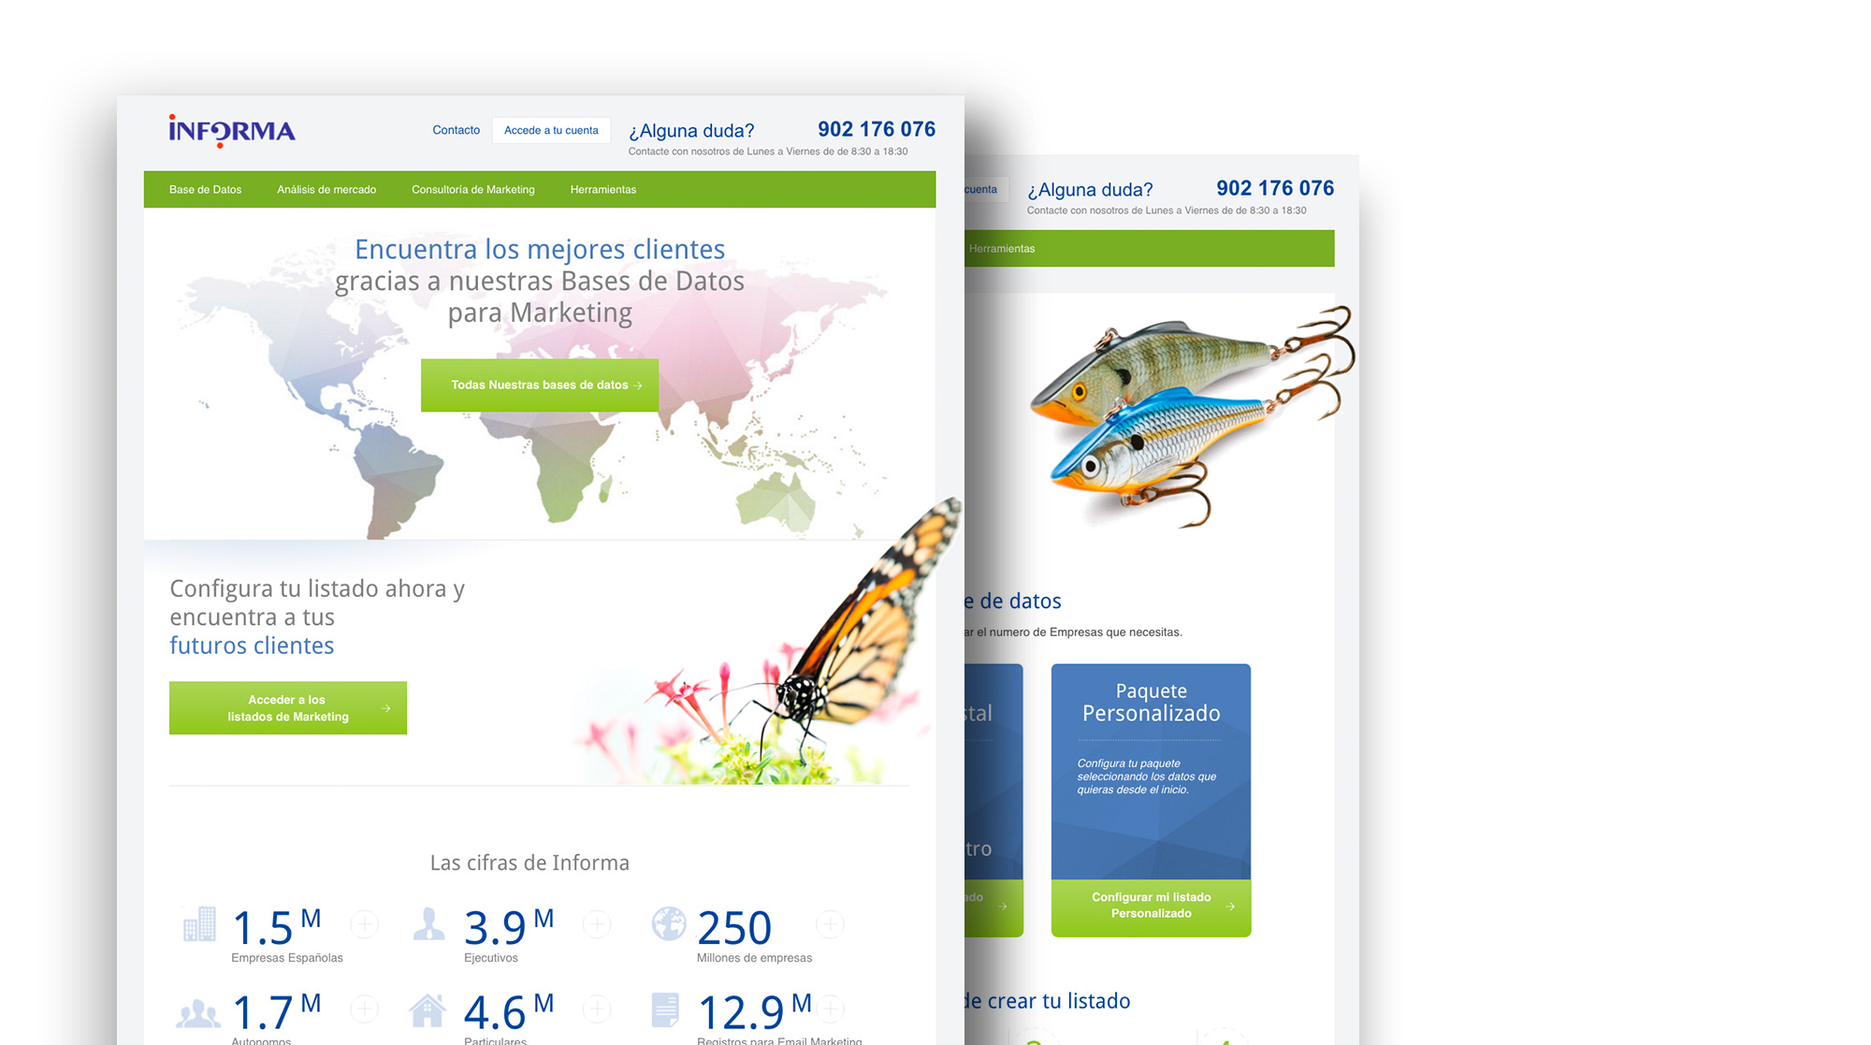
And finally, we developed our first web with
www.marketinginforma.es
www.einforma.com/marketing

Slide 8
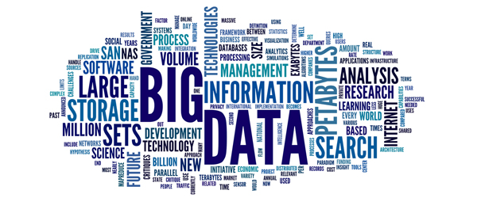
How to manage all the growth and sustain the quality expected by our customers?
The solution was in…

Slide 9

The new informa
Contributes
LAKE
Own
Data
Uses
Contains
Uses
Analytics and statistics Capacities
USER
(Decides)
Uses
Own Software
INFORMA Software
Value Added
Products
Access through
Multiple Devices

Slide 10
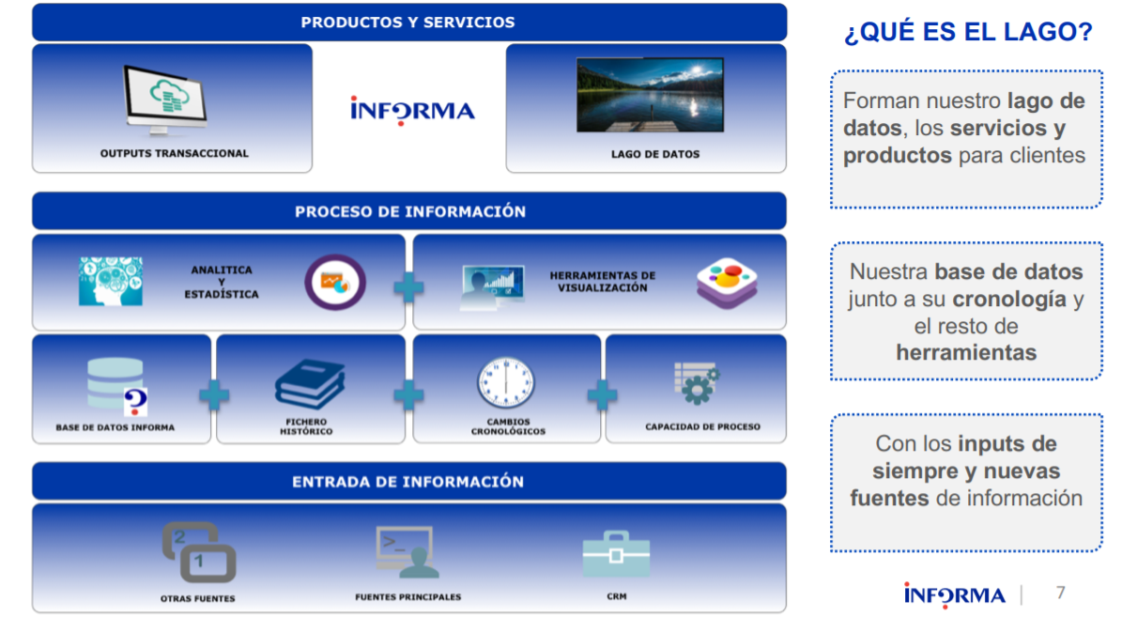
What is the Data Lake?
Services and products for Customers
Our database along with the chronology and the other tools
With all the inputs and new information sources
10

Slide 11


What are we going to obtain with the data lake?
We need the 5 V’s of Big Data if we need to maintain our competitive advantage
(Variety, Volume, Velocity, Veracity y Value)
We want to do new things using the new tools, mainly, to come closer to the reality of the customer in order to help them in decision-making

Slide 12
And all this, What it means?
For us, the Data lake is our “new house ”, it is not simply a tool that allows statistical treatments
And this means that we are going to retype all our software in order to adapt it to the new architecture
Above all: we have to teach our software developers to work in the new architecture
(It is easier than teaching new software developers the “trade” of doing data bases)

Slide 13




Is it easy for us?
NO. The programming and design schemes are very different
The old architecture and the new one are coexisting at the same time
IS THERE ANY ADDITIONAL ADVANTAGE?
To prove is much more efficient (we can prove “with almost everything”)
The production readiness is far easier. We might “be mistaken” with less fear than before

Slide 14
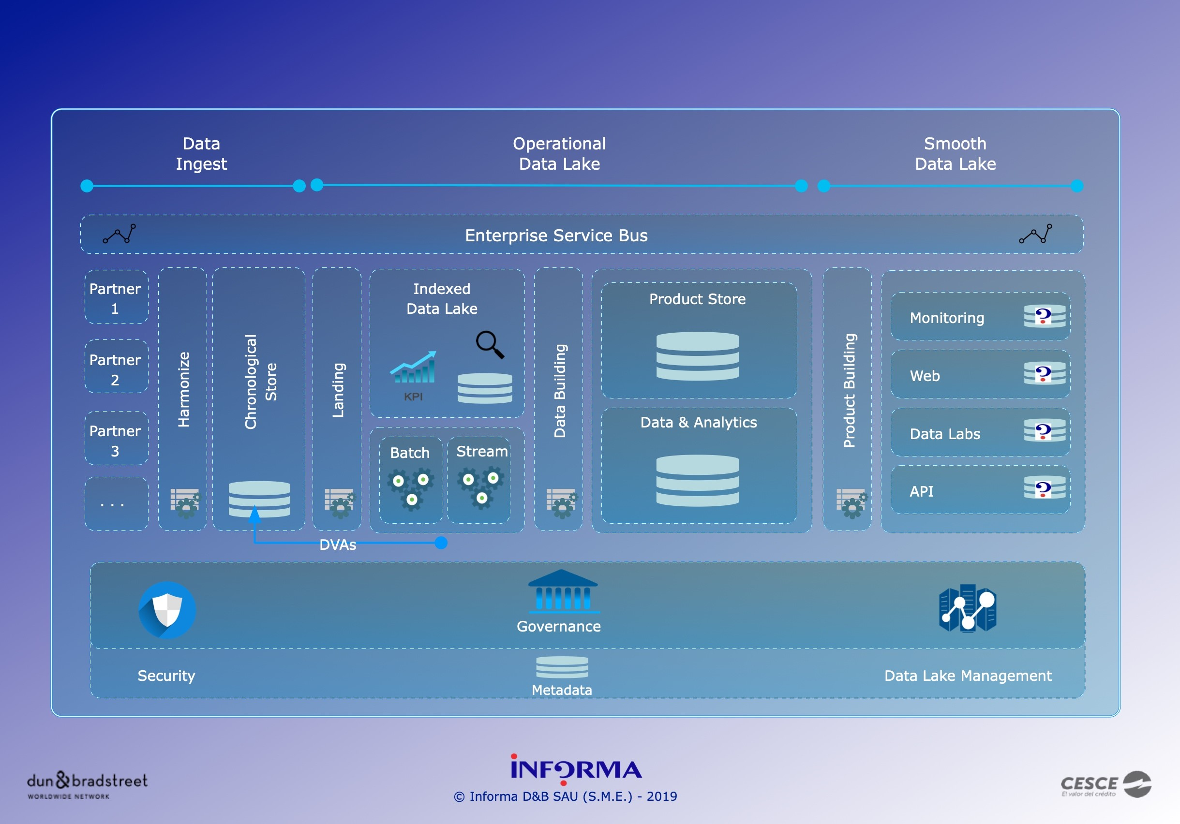

Slide 15




DATA STRATEGY
To maintain a catalogue of terms, data sources and uses
Data knowledge
Risk Management and Compliance
Improving growth
01
03
05
Not to comply with the control activities only, but facilitate the development of analytical capacities to promote sales and to reduce costs
To guarantee the data reliability and the protection of the customers privacy
02
04
Operating efficiency
Sharing of knowledge
Redesign and automate the processes of data generation and reports
Democratize data access and use by seizing synergies among business units
“Defensive” measures
“Offensive” measures
Source: PricewaterhouseCoopers

Slide 16


DATA GOVERNANCE MODEL
Data
architecture
Data Modelling
& Design
Data
Quality
Data
Storage &
Operations
Data
Governance
Data
Security
Metadata
DAMA International proposes the following reference model for the information management
End-to-end management of data and facilitate its exploitation
Data
Warehousing
& Business
Intelligence
Data
Integration & Interoperability
Reference & Master Data
Document &
Content
Management
Source: DAMA International and PwC

